Slide 1
TERMS AND CONDITIONS
These PowerPoint slides are a tool for lecturers, and as such:
YOU MAY add content to the slides, delete content from the slides, print out the slides, and save the slides onto your computer or server.
YOU MAY NOT resell, reproduce or redistribute the content in any form whatsoever, without prior written permission from the copyright holder.
© Troupant Publishers (Pty) Ltd, 2016
Selected images used under licence from Shutterstock.com

Slide 2
Engineering Systems
NQF Level 2

Slide 3
Selecting engineering systems applications
Module 7

Slide 4
Gear trains
Unit 7.1

Slide 5
Types of gear trains
A gear train is series of gears.
Gear trains are used to transmit a motion and power from one shaft to another.
Main types of gear trains:
Simple gear trains.
Compound gear trains.

Slide 6
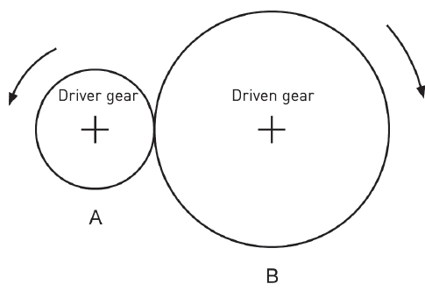
Types of gear trains
Simple gear train
Figure 7.1 A simple gear train

Slide 7
Types of gear trains
Simple gear train
Figure 7.2 An idler gear in a gear train

Slide 8
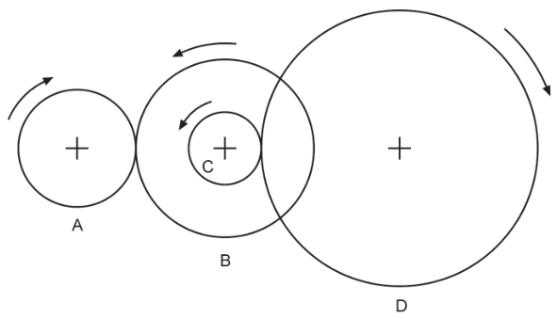
Types of gear trains
Compound gear train
Figure 7.3 A compound gear train

Slide 9
Applications of gear trains
The size of a gear is usually specified in one of three ways:
Diameter or radius of the gear.
The circumference of the gear.
The number of teeth on the gear.

Slide 10
Gear drives compared to other drives
Advantages and disadvantages of gear drives compared to other drives.
Advantages | Disadvantages
Compact in size. | Requires a lubrication plan.
The velocity ratio (VR) remains constant. | Costly to manufacture.
Can transmit more power compared to other drives. | Requires skilled personnel to manufacture and is not easy.
Very reliable. | Requires exact alignment of shafts.

Slide 11
Belt drives
Unit 7.2

Slide 12
Defining a belt drive
A belt drive is a method of transferring rotary motion between two shafts.
It consists of one pulley on each shaft and one or more continuous belts over the two pulleys.

Slide 13
A belt drive
Figure 7.5 A belt drive used on a car engine

Slide 14
Belts
A belt is flexible material looped over two pulleys.
Belts types include:
V-belts.
Flat belts.
V-ribbed belts.
Synchronous belts.

Slide 15
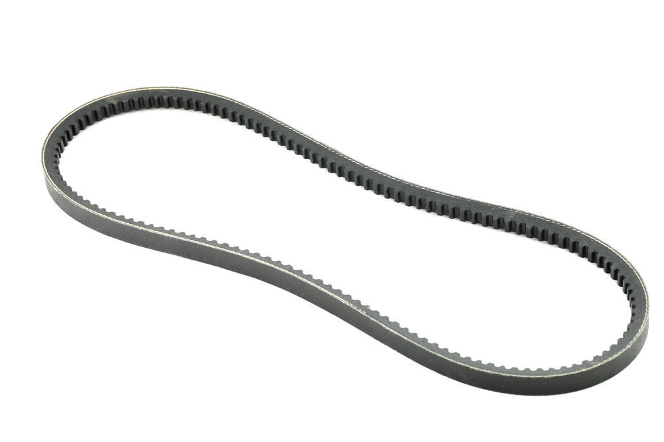
Types of belts
V-belts
Figure 7.6 A V-belt

Slide 16
Types of belts
V-belts
Figure 7.7 Construction of a V-belt

Slide 17
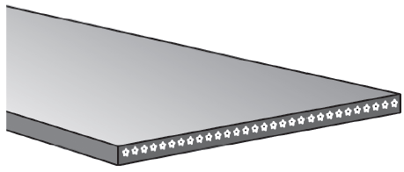
Types of belts
Flat belts
Figure 7.8 A flat belt

Slide 18
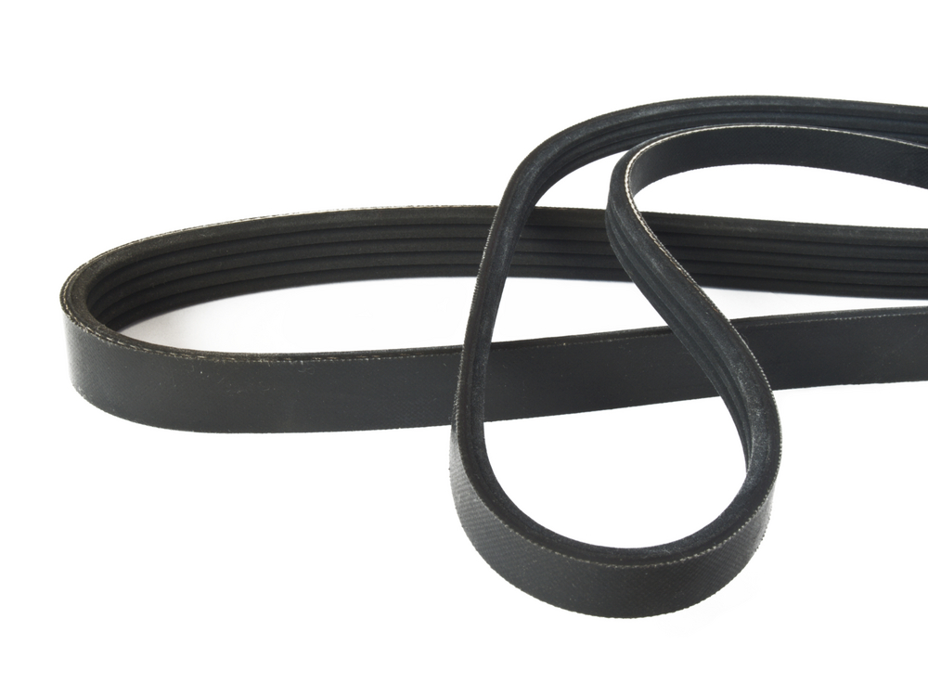
Types of belts
V-ribbed belts
Figure 7.9 A V-ribbed belt

Slide 19
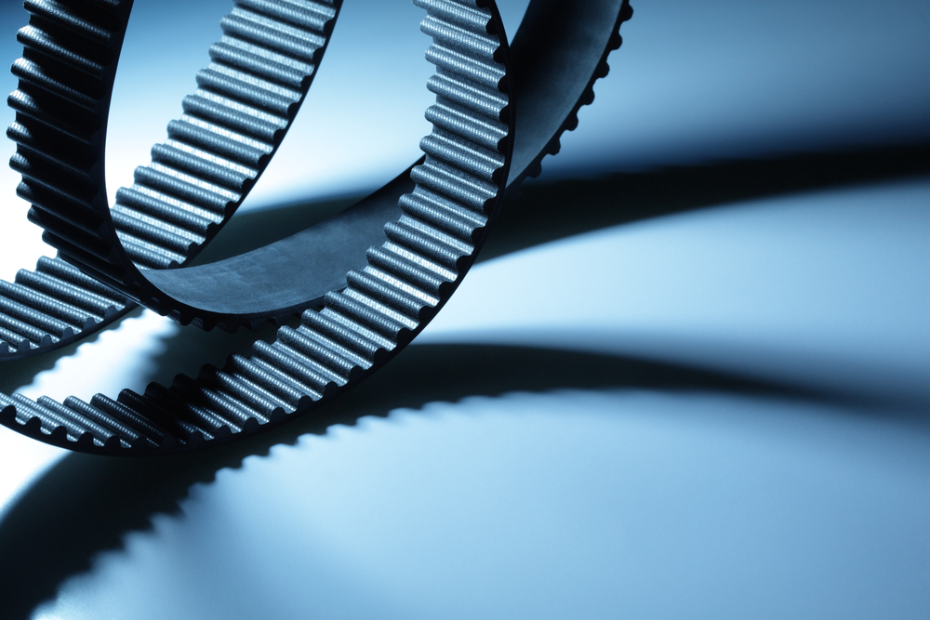
Types of belts
Synchronous belts
Figure 7.10 A timing belt

Slide 20
Belt friction
Factors that affect belt friction include:
Belt tension.
The wedge angle.
The materials from which the belt and pulleys are made.

Slide 21
Belt tension
Loose
Figure 7.11 Checking belt tension

Slide 22
Belt tension
Figure 7.12 Using a tension tester

Slide 23
How to adjust belt tension
Figure 7.13 An idler pulley and a
belt tensioner used in a car engine

Slide 24
Belt wear and slip
Belt wear is caused by:
Stress from rolling around the pulleys.
High belt tension.
Excessive slippage.
Adverse environmental conditions.
Belt overload caused by shock, vibration or belt slapping.

Slide 25
Pulley configurations
Belts are looped over pulleys.
In a two-pulley system, the belt can drive the pulleys in the same direction (open belt drive).
Or the belt may be crossed so that the shafts rotate in the opposite direction (cross belt drive).

Slide 26
Pulley configurations
Figure 7.14 An open belt drive
Figure 7.15 A cross belt drive

Slide 27
Pulley configurations
Figure 7.16 Using pulleys
to change speed

Slide 28
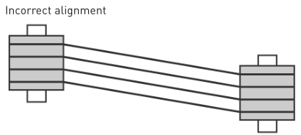
Alignment of pulleys
Figure 7.17 Correct pulley alignment
Figure 7.17 Incorrect pulley alignment

Slide 29
Mounting a motor
Figure 7.18 Motor mounted on side rails

Slide 30
Mounting a motor
Figure 7.19 Position of side rails (top view)

Slide 31
Advantages and disadvantages of belt drives
Advantages and disadvantages of belt drives
Advantages | Disadvantages
No lubrication is required. | Belts usually cannot be repaired when they break – they must be replaced.
Minimal maintenance. | Slippage can occur.
Belts dampen sudden shock loads. | Adverse service environments can damage belts or cause severe slipping.

Slide 32
Advantages and disadvantages of belt drives
Advantages and disadvantages of belt drives (continued)
Advantages | Disadvantages
They are quiet and smooth in operation. | It is important to prevent oil from spilling onto the belt.
Pulleys are usually less expensive than other types of drives and show little wear over long periods of operation. | Belt drives need a tensioning mechanism.
They can operate at a high rotational speed.

Slide 33
Chain drives
Unit 7.3

Slide 34
Defining a chain drive
A chain drive is a method of transmitting mechanical power and reducing slippage.

Slide 35
A chain drive
Figure 7.20 A chain drive

Slide 36
Sprocket
Three different types of sprockets on a chain drive
Type | Description
Driver sprocket | Attached to the motor shaft and is smaller than the driven sprocket.
Driven sprocket | Attached to the driven shaft and is bigger than the driver sprocket.
Idler or jockey sprocket | Used to take up the slack between the shafts.

Slide 37
Chains
Roller chains are the best known of all chains.
Constructed by connecting two side plates with pins that have bushings and rollers attached.

Slide 38
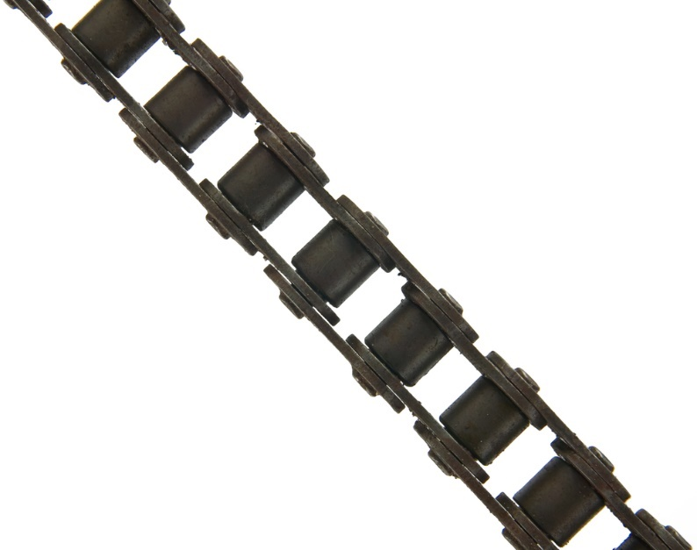
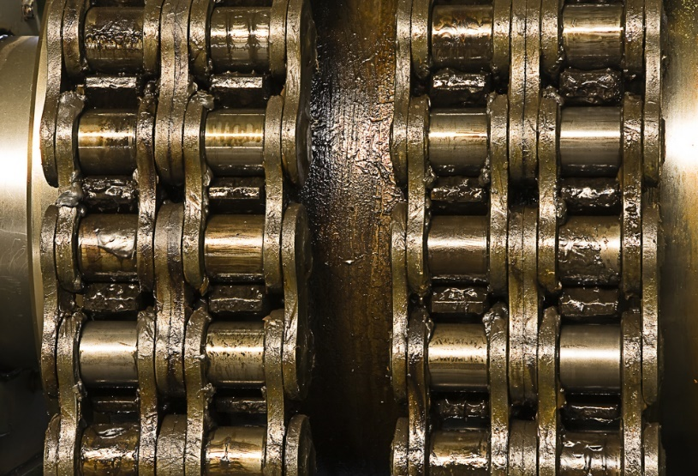
Chains
Roller chains
Figure 7.21 A simplex roller chain
Figure 7.22 A duplex roller chain

Slide 39
Roller chains
Pitch
Figure 7.23 A single-pitch roller chain

Slide 40
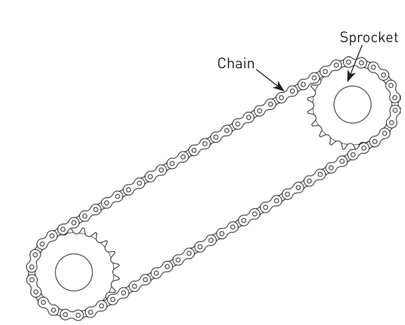
Roller chains
Shaft centre distance
Figure 7.24 Sprockets with chain

Slide 41
Chains
Leaf chains
Figure 7.25 A leaf chain

Slide 42
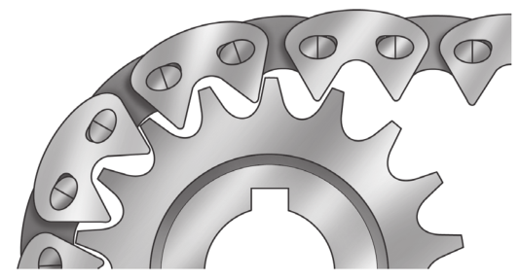
Chains
Silent (inverted tooth) chains
Figure 7.26 A silent chain

Slide 43
Advantages and disadvantages of chain drives over belt drives
Advantages and disadvantages of chain drives over belt drives
Advantages | Disadvantages
There is no slippage between chain and sprocket teeth. | Chain drives are more noisy than belt drives.
There is negligible stretch. | Chain drives can elongate.
They can operate in hostile environments. | Chain flexibility is limited to a single plane.
They have a long shelf life. | Chain drives are usually limited to lower-speed applications.

Slide 44
Advantages and disadvantages of chain drives over belt drives
Advantages and disadvantages of chain drives over belt drives (continued)
Advantages | Disadvantages
Certain types can be replaced without disturbing other components mounted. | Sprockets should be replaced because of wear when a worn chain is replaced.
Each link of a chain drive transmits load in tension to and from the sprocket teeth. | Chain drives require housing.

Slide 45
Brake systems
Unit 7.4

Slide 46
Hydraulic brakes
The pressure that is applied to the brake pedal is transmitted to the brake system via brake fluid.

Slide 47
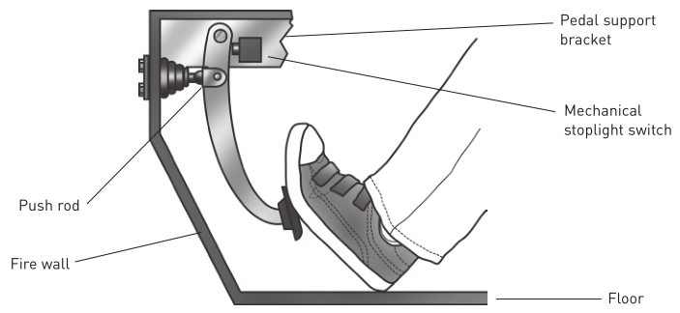
Hydraulic brakes
Figure 7.27 The brake pedal

Slide 48
Hydraulic brakes
Figure 7.28 A hydraulic brake system

Slide 49
Air brake systems
Operate in a similar way to hydraulic brakes but compressed air is used to actuate the brakes.

Slide 50
Air brake systems
Components of an air brake system:
A compressor to pump air.
A reservoir or tank to store compressed air.
A foot valve to regulate flow of air.
Brake chambers and slack adjusters to transfer the force exerted by compressed air.
Brake linings and drums or rotors to create friction.

Slide 51
Air brake systems
Figure 7.30 An air brake system

Slide 52
Thruster brakes
Thruster brakes are used in large industrial lifting equipment so that if power fails, the load will not fall to the ground.
Centrifugal pump stops and the braking spring applies the brakes.

Slide 53
Thruster brakes
Figure 7.31 Thruster brakes

Slide 54
Electromagnetic brakes
Are similar to thruster brakes, except that the brake shoes are held away from the drum by an electromagnet rather than hydraulic pressure.

Slide 55
Electromagnetic brakes
Figure 7.32 Electromagnetic brakes

Slide 56
VIDEO: Electromagnetic brake

Slide 57
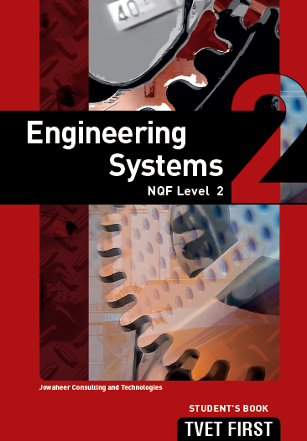
Summative assessment
Test your knowledge of this section by completing the Summative assessment (page 117 of your Student’s Book)

